Slide 1
Asexual- Sexual Reproduction

Slide 2
Reproduction:
The continuity of life
Reproduction
Sexual
Reproduction
Asexual
Reproduction

Slide 3
Asexual Reproduction
A process resulting in the production of genetically identical offspring from one parent.

Slide 4
Asexual Reproduction: Genetically Identical Offspring
Budding
Regeneration
Parthenogenesis
Mitosis
Cloning

Slide 5
What is Asexual Reproduction?
Only one parent is involved then the new organism divided by mitosis .
Offspring are genetically identical to their parents , new organism obtains a set of chromosomes – long threads of DNA – each chromosomes contain set of instructions known as genes .
We call the organisms that have same genes clones.

Slide 6
 | Sexual Reproduction | Asexual Reproduction
Definition | Involves sex cells and fertilisation Two parents | Does not involve sex cells and fertilisation Only one parent plant
Advantages/ Disadvantages | Offspring are not genetically identical to one another There is variation in the offspring | Offspring have no variation Offspring are genetically identical to one another

Slide 7
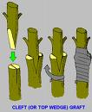
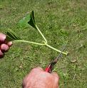
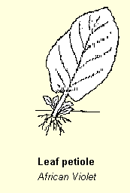
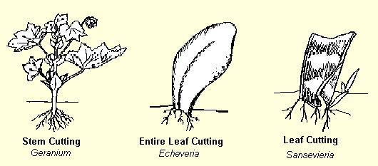
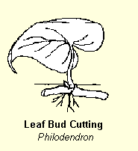
Artificial Propagation
Grafting
Cutting

Slide 8


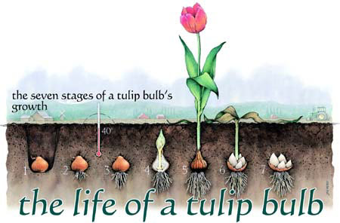
Asexual reproduction
Also known as vegetative propagation
3 methods of vegetative propagation in plants
runners
bulbs

Slide 9
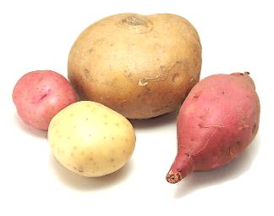
Tubers
Tubers are underground food stores which stores food over the winter and provides a new plant with food until it can make its own.
Examples: potato, Yam,
Food made by the new plant is sent to make new tubers. Thereby reproducing itself.
Notes:
Tuber info from http://www.foodsubs.com/Tubers.html

Slide 10
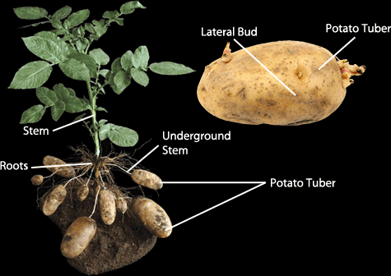
Bud eye

Slide 11
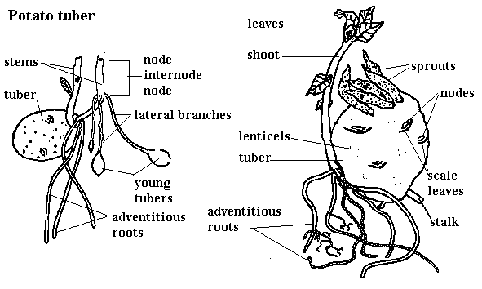

Slide 12
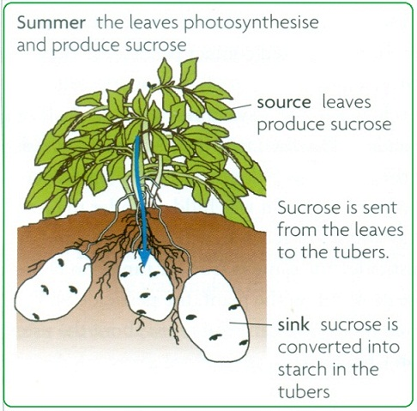

Slide 13
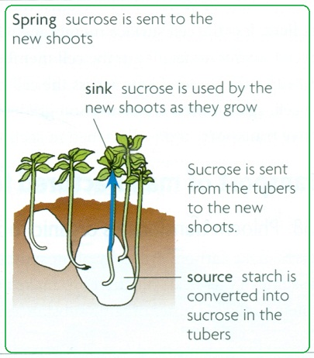

Slide 14
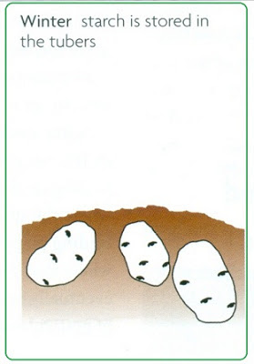

Slide 15
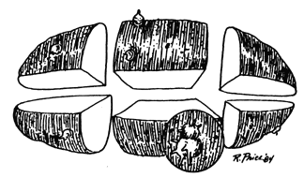
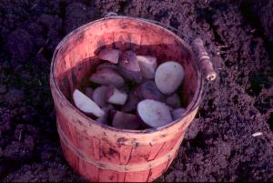
Potato can be cut into several pieces , as long as each piece has a bud on it , it can grow into a complete a new plant.

Slide 16
Advantages of asexual
1- quickly and efficiently produce many new plants
2- all genetically identical to one another
*Used for wanted characteristics
Such as – attractive flowers , good flavour, high yield

Slide 17
Sexual reproduction a process involving the fusion of the nuclei of two gametes to form a zygote and production of offspring that are genetically different from each other .

Slide 18
Sexual reproduction
Sexual reproduction is the production of offspring from two parents using gametes – egg and sperm .
Fertilisation- the fusion of two nuclei gametes- to form a diploid zygote - contains chromosomes from both its parents .
The cells of the offspring have two sets of chromosomes (one from each parent), called diploid.
The offspring are genetically different from each other and from their parents .

Slide 19
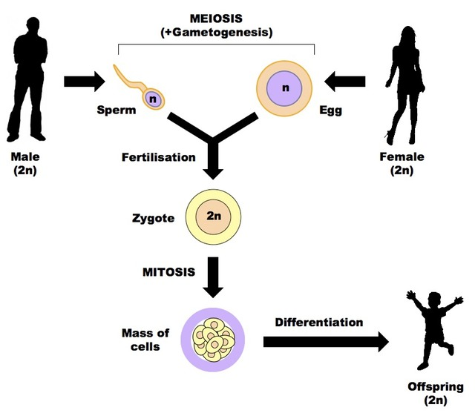
Testes
Ovaries
23
23
46
46
46
46

Slide 20
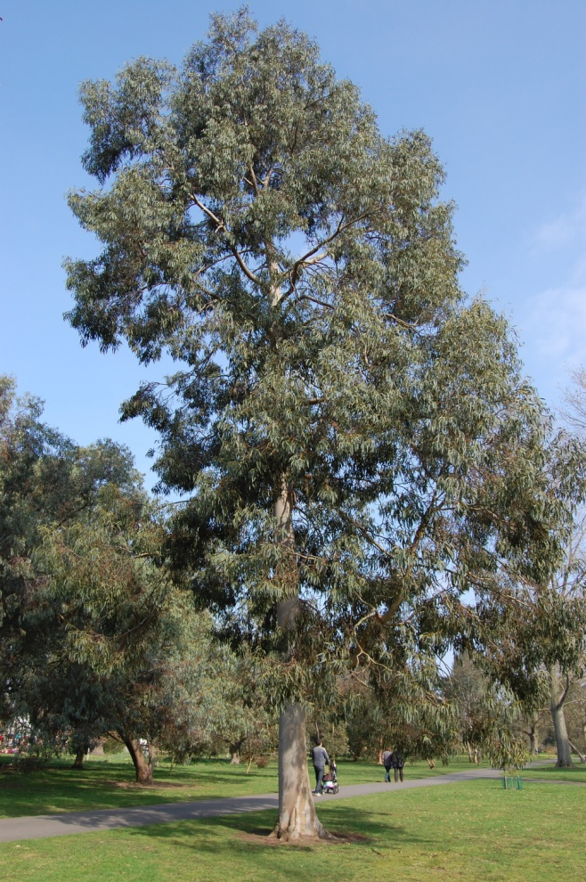
Eucalyptus tree plant
22 chr.
Pollen grains - anthers
11
11
Eggs in ovary
Seed 22 chr.

Slide 21
Meiosis
Meiosis is only happens when gametes are being made .
Produces new cells with only half as chromosomes as parent cell .

Slide 22
Male and female gametes
Two different kinds of gametes
In human : sperm + egg or ova
In flowering plant : pollen grain+ ovule
Female gametes : quite large , does not move much
Male gametes : smaller , usually move actively .
It dose not move by itself , but is carried by a pollen tube

Slide 23
Hermaphrodite
Organism can produce both sorts of gametes
Such as earthworm , slugs and flowering plants .
But all mammals are either male or female. depending on what gamete it makes .

Slide 24
Sexual & asexual reproduction
Sexual reproduction:
Two parents
Fusion of a female & male cells (gametes)
Parent & offspring are not identical
Slower
Variation is present in the same species
Asexual reproduction:
One parent only
No gametes are produced
Parent and offspring are identical
Faster
No variation / plants becoming vulnerable to attack by a pest or disease . Ex. Banana

Slide 25
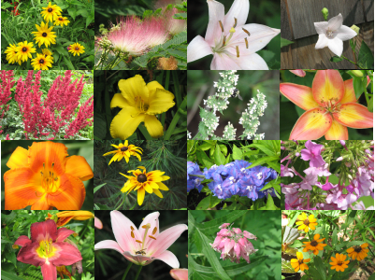
Sexual Reproduction In Flowering Plants

Slide 26
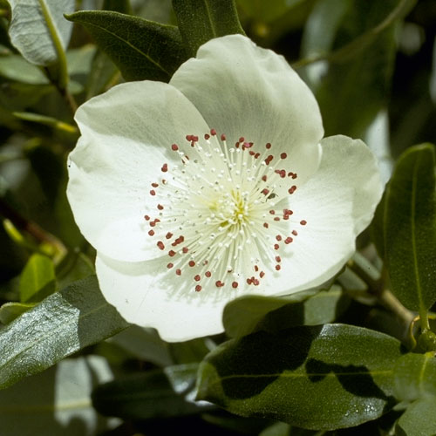
Eucryphia flowers – hermaphrodites.
Most but not all flowers are hermaphrodites .
function of flowers
1- make gametes
2- ensure that fertilization will take place
- Note : flower is parts of plants, not plants itself.

Slide 27
Parts of a Flower
Petal
Stigma
Style
Stamen
Anther
Carpel
Filament
Ovary
Ovule
Nectary
Sepal
Receptacle
Flower stalk

Slide 28
Flower Part | Part Function
Petal | These are used to attract insects into the flower, they may have guide-lines to guide insects to the base of the petal
Stigma | Is covered in a sticky substance ,the pollen grains will stick to.
Style | It raises the stigma away from the ovary to decrease the likelihood of pollen contamination. It varies in length.
Ovary | Ovules are produced inside this.
Ovule | This will become a seed once fertilisation has taken place. Female parts.
Stamen | collective name for the anther and the filament. Male parts
Flower Stalk | Gives support to the flower and elevates the flower for the insects.
Nectary | Gland that produce a sugary solution called nectar. Insect food
Sepal | These protect the flower whilst the flower is developing from a bud.
Filament | This is the stalk of the anther.
Anther | Pollen grains is produced here contain the male gamete.

Slide 29
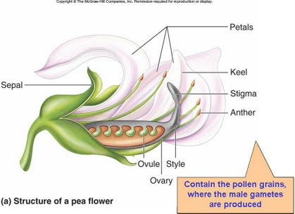
fertilisation
It is the joining of male and female cells to produce a zygote.
Ovary Fruit
Ovary wall Fruit cover
Ovule Seed
placenta

Slide 30
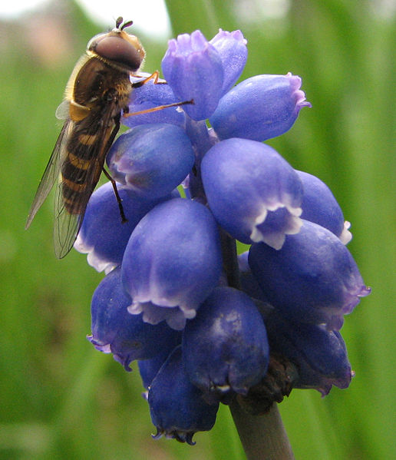
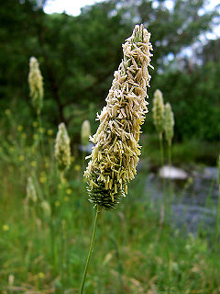
Pollination
It is the transfer of pollen grains from the anthers to the stigma
Pollinating agents
Insects Wind

Slide 31
Insect pollinated
Wind pollinated
Have large colored petals with guide lines
Have a scent
Have a nectary on which insects feed
Have a sticky stigma for pollen grains to stick on it
The female and male organs are inside the flower
Pollen grains are larger with spiky or sticky to hold on insect body
Large quantity of pollen made , eaten or delivered wrongly
Have small green petals, no guide lines, or no petal at all
Have no scent
Have no nectary
Have a feathery and large stigma to catch the pollen in the air
The female and male organs are hanging outside the flower
Pollen grains are smooth, smaller & light weight to be carried by wind
Very large quantity of pollen made , most blown away and lost

Slide 32
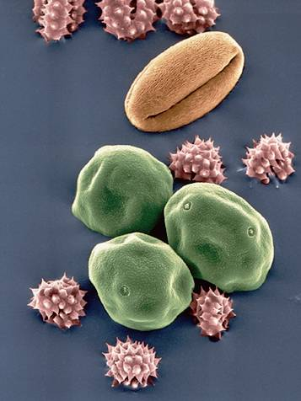
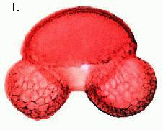
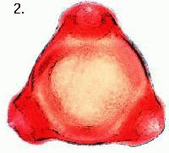
Pollen grains as seen under the microscope
Can you tell which belongs to insect pollinated flowers / wind pollinated flowers?

Slide 33
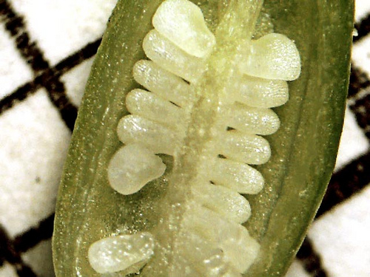
Ovary
Many ovules , these cells have female gametes
Anther
Has 4 sacs
Some of the cells around the edge of the pollen sacs divide by meiosis to make pollen grains .
Then anther split open
Fine yellow powder – pollen grains
Surrounded by hard coat- protection
Male gametes inside the grains

Slide 34
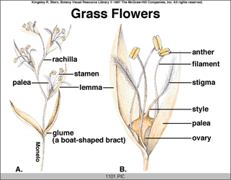
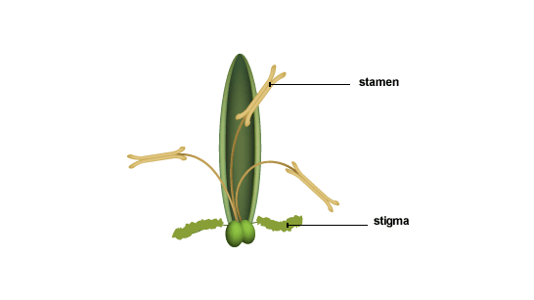

Slide 35
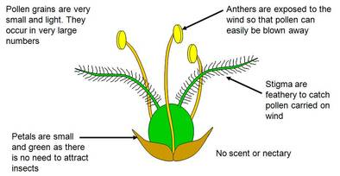

Slide 36
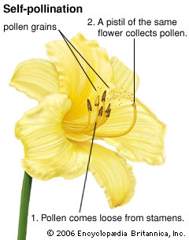
Pollination
Self-pollination
Pollen from the anther is transferred to the stigma in same flower
Or to another flower on the same plant.

Slide 37
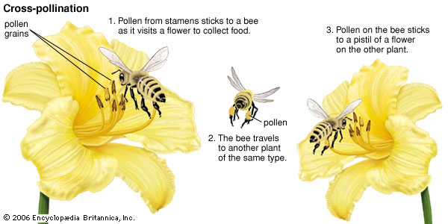
Cross pollination
Pollen from the anther of one plant is transferred to the stigma of a different plant at the same species .

Slide 38
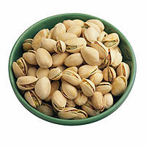
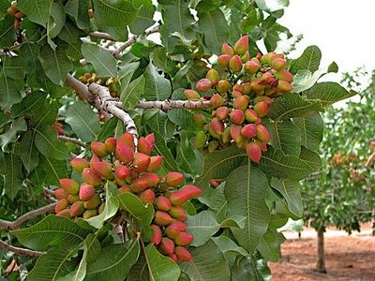
Prevent self – pollination
Some plants produce only flower of a single sex which makes self pollination impossible – pistachio trees are single sex

Slide 39
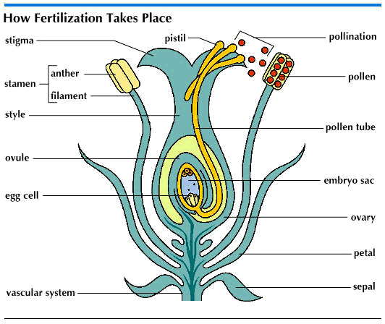
When a pollen grain lands on the stigma, it germinates and a pollen tube grows down through the style to an ovule.

Slide 40
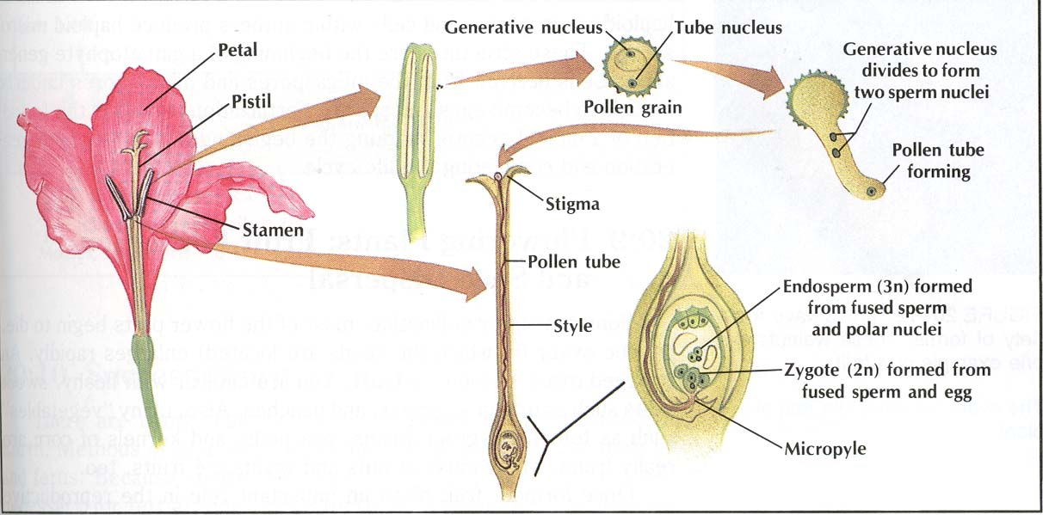
Fertilization
The pollen travels through the pollen tube to the ovule. The nucleus of pollen & nucleus of ovule fuse forming the zygote (fertilized egg) –this grows into the plant embryo (cells grow by mitosis)
Digestive enzymes
Few contain more than one carpel

Slide 41
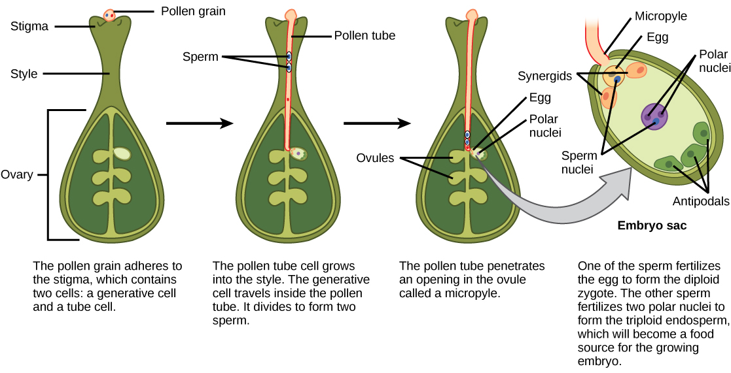

Slide 42
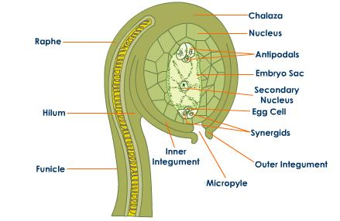

Slide 43
Seeds
Ovules have been fertilized many parts of flower are not needed any more , sepals , petals and stamens . fall off
Inside the ovary ovules start to grow each contain zygote divides by mitosis to form an embryo
The ovule called seed
the integuments of the ovule become dray and hard to form testa of seed for protection against damage , bacterial fungal infection .

Slide 44
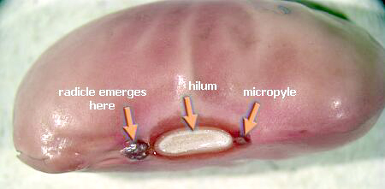
micropyle –opening in ovule where pollen tube attached, pollen entered hilum –scar where ovule attached to ovary- placenta .. With pod radicle –embryonic root plumule : which will grow into a shoot
Seedling
embryo

Slide 45
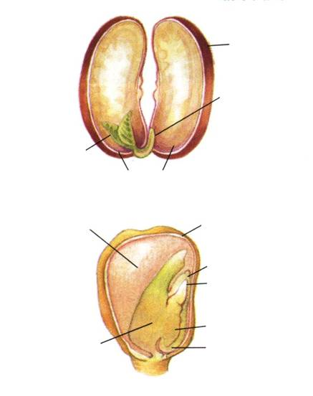
The plant embryo uses food stored in the cotyledon of the seed until it develops leaves for photosynthesis, it contains starch or proteins also contain enzymes
Seed coat
Hypocotyl
Epicotyl
Cotyledons
Endosperm
Seed coat
Epicotyl
Hypocotyl
Cotyledon
Radicle

Slide 46
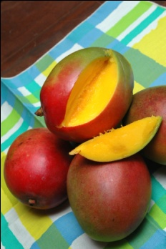
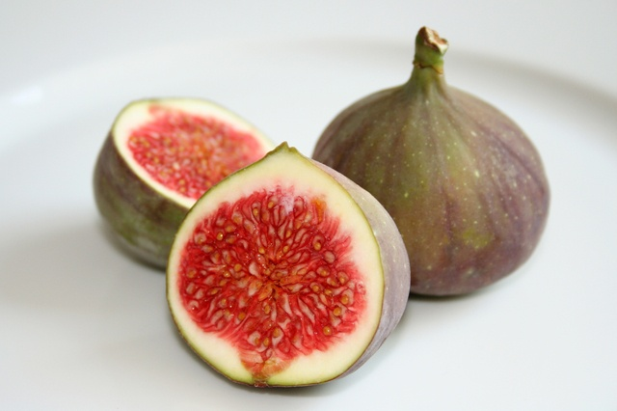
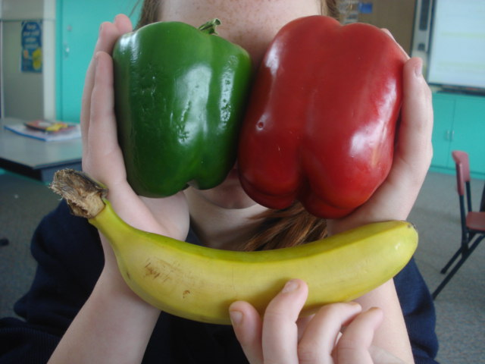
*The ovule forms the seed and the ovary forms the fruit.
A fruit is a ripened ovary
Pea pod is fruit

Slide 47
Endospermic seeds
Like wheat, rice contain a large endosperm which is food storage
In some plants as the embryo plant develops the endosperm is used up to make large storage organs called cotyledons – in non endospermic seeds like beans and peas

Slide 48
Seeds germination
Seeds contains hardly any water . Dehydrated
Almost no metabolic reactions can go inside it
The seed is inactive/ dormant , survive in harsh conditions
A seeds must be in certain conditions before it will begin to germinate

Slide 49
Germination
Germination begins when the seed absorb large amount of water through the micropyle.
Seed swell and testa is burst.
Water help to provide right environment for enzymes
The enzyme become active to break down large carbohydrate to smaller sugars , amylase break down starch to maltose , protease break down the protein to amino acid .
Maltose and amino acid dissolved in water and diffuses to the embryo which are used in respired to provide energy until seedling is able to produce its own supply by photosynthesis and growth.

Slide 50
Germination
Rate of respiration rises
Needing a good supply of O2
Respiration tends to transfer some waste energy as heat .. Warm up slightly
Germination does not need light , and may be inhibit by light
But new seedling will grow rapidly towards a light source
Plants grown in low light condition is that they become taller than usual and often very thin and yellowish

Slide 51
Seed germination
Once a seed falls onto a suitable surface it starts to grow.
Conditions required for seed germination:
Suitable temperature
Oxygen
Water

